Slide 1
Learning Objective
I will be able to solve optimisation problems from a wide variety of fields using first and second derivatives
Success Criteria
At the end of the lesson, I will be able to:
Apply the first and second derivative test to solve optimisation problems

Slide 2
Optimisation
Optimisation involves applied situations where we need to find the optimal solution to the problem.
For example, if we are looking to produce cans of food, we want to find the optimal solution that will MAXIMISE profits and MINIMISE costs. Note that this involves finding a maximum/minimum which means calculus can be applied to these situations.
Each problem in optimisation is unique in situation, but the process is the same!

Slide 3
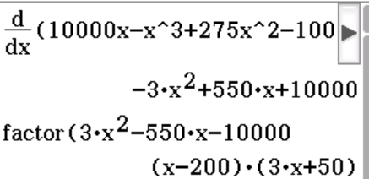
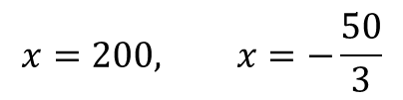
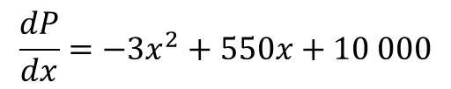

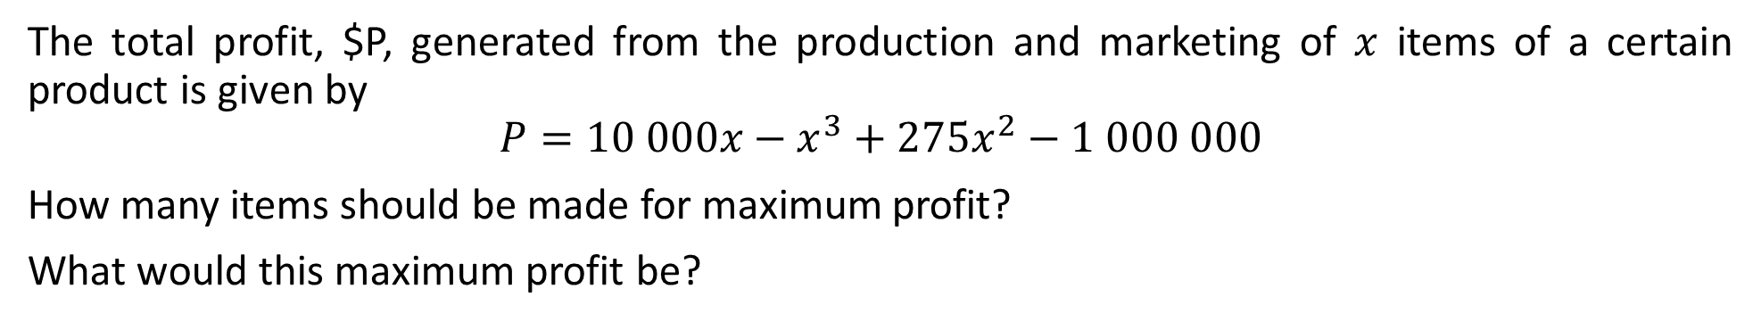





Guided Practice
The total profit, $P, generated from the production and marketing of $x$ items of a certain product is given by
$$P=10 000x−x^{3}+275x^{2}−1 000 000$$
How many items should be made for maximum profit?
What would this maximum profit be?
$$\frac{dP}{dx}=−3x^{2}+550x+10 000$$
Subst $x=200 into P$
$$P=4 000 000$$
Maximum profit is $4 000 000
$$0=−3x^{2}+550x+10 000$$
$$3x^{2}−550x−10 000=0$$
$$\left(x−200\right)\left(3x+50\right)=0$$
$$x=200, x=−\frac{50}{3}$$
$x≠−\frac{50}{3}$, because x cannot be negative
$∴x=200$, number of items = 200 for maximum profit

Slide 4
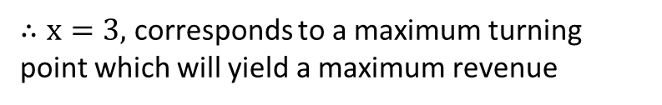

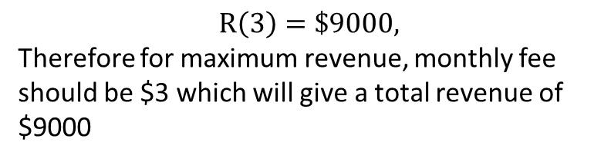
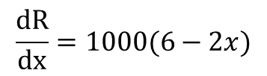



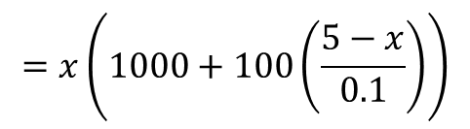



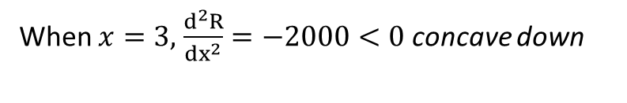


Guided Practice
A TV cable company has 1000 subscribers who are paying $5 per month. It can get 100 more subscribers for each $0.10 decrease in monthly fee. What monthly fee will yield the maximum revenue and what will this revenue be?
Let $x=$ denote new monthly fee
$$\frac{dR}{dx}=1000(6−2x)$$
No. of subscribers is $1000+100\left(\frac{5−x}{0.1}\right)$
Sub $\frac{dR}{dx}=0, 1000\left(6−2x\right)=0$
$$x=3$$
When $x=3,$ $\frac{d^{2}R}{{dx}^{2}}=−2000<0$ concave down
$∴x=3,$ corresponds to a maximum turning point which will yield a maximum revenue
Let $R=$ denote revenue earned
$$R=x×no. of subscribers$$
$$=x\left(1000+100\left(\frac{5−x}{0.1}\right)\right)$$
$$R\left(3\right)=\$9000,$$
Therefore for maximum revenue, monthly fee should be $3 which will give a total revenue of $9000
$$R=x\left(1000+1000\left(5−x\right)\right)$$
$$R=1000(6x−x^{2})$$

Slide 5
Guided Practice
1000 cm³ of metal is to be cast as a rectangular block with square ends. Use calculus to show that for the least surface area the rectangular block needs to be a cube.

Slide 6

Guided Practice
1000 cm³ of metal is to be cast as a rectangular block with square ends. Use calculus to show that for the least surface area the rectangular block needs to be a cube.
If necessary, SET UP A DIAGRAM FIRST!
Read the information
in the question
carefully.
KEYWORDS:
1000cm³ (VOLUME)
Rectangular block
with SQUARE ENDS
LEAST surface area
(need to differentiate
a surface area formula
and find a minimum)

Slide 7

Guided Practice
1000 cm³ of metal is to be cast as a rectangular block with square ends. Use calculus to show that for the least surface area the rectangular block needs to be a cube.
Differentiate the S.A. formula
Find the stationary
points and check if
they give a minimum
for the LEAST S.A.
ANSWER THE QUESTION!!!
SHOW THAT THE DIMENSIONS OF THE BLOCK NEEDS TO BE A CUBE FOR THE MINIMUM SURFACE AREA.

Slide 8



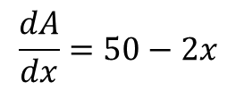






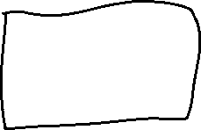


Guided Practice
Find the maximum area of rectangular field that can be enclosed by 100 m of fencing.
$$P=2x+2y$$
$$100=2x+2y$$
$$x+y=50$$
$$y=50−x$$
$$A=xy$$
$$A=x(50−x)$$
$$=50x−x^{2}$$
Hence $x=25$ will be the max. turning point and give the max. area
$$A=25\left(50−25\right)$$
$$\frac{dA}{dx}=50−2x$$
$$A=625 m^{2}$$
To find max area $\frac{dA}{dx}=0, 50−2x=0$
$$x=25$$
$\frac{d^{2}A}{dx^{2}}=−2<0∴$ graph concave downs

Slide 9
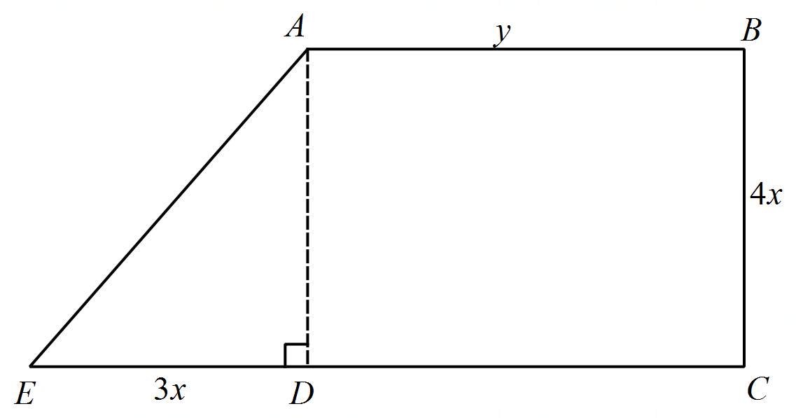
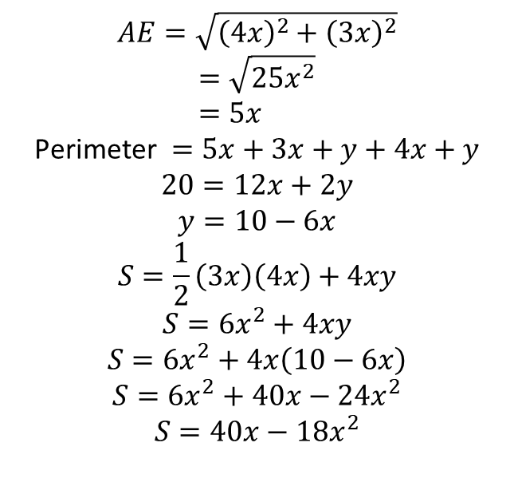
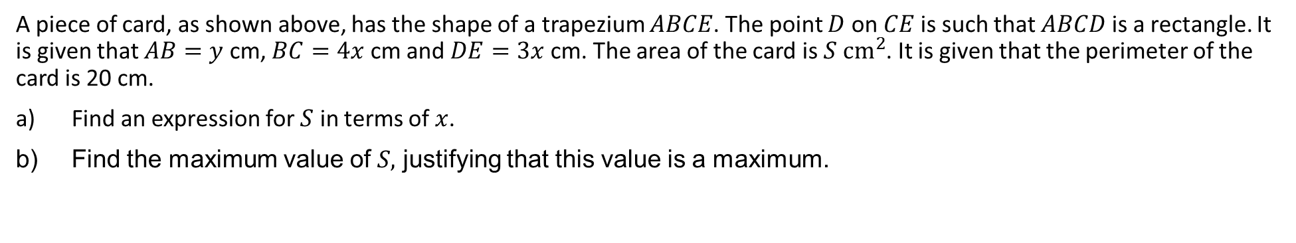
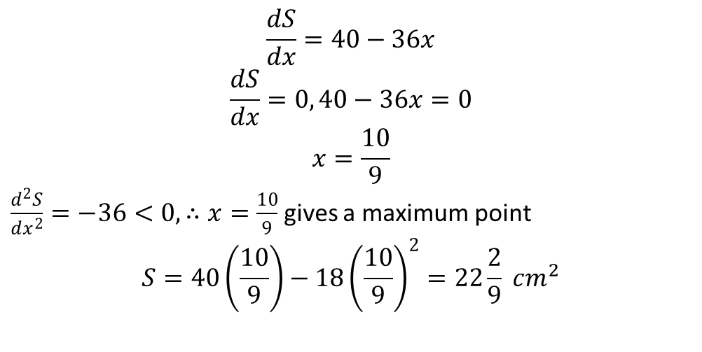
Guided Practice
A piece of card, as shown above, has the shape of a trapezium $ABCE$. The point $D$ on $CE$ is such that $ABCD$ is a rectangle. It is given that $AB=y$ cm, $BC=4x$ cm and $DE=3x$ cm. The area of the card is $S cm^{2}$. It is given that the perimeter of the card is 20 cm.
Find an expression for $S$ in terms of $x$.
Find the maximum value of $S,$ justifying that this value is a maximum.
$$AE=\sqrt{{\left(4x\right)}^{2}+{\left(3x\right)}^{2}}$$
$$=\sqrt{25x^{2}} \\ =5x$$
$$\text{Perimeter} =5x+3x+y+4x+y$$
$$20=12x+2y$$
$$y=10−6x$$
$$S=\frac{1}{2}\left(3x\right)\left(4x\right)+4xy$$
$$S=6x^{2}+4xy$$
$$S=6x^{2}+4x\left(10−6x\right)$$
$$S=6x^{2}+40x−24x^{2}$$
$$S=40x−18x^{2}$$
$$\frac{dS}{dx}=40−36x$$
$$\frac{dS}{dx}=0, 40−36x=0$$
$$x=\frac{10}{9}$$
$\frac{d^{2}S}{dx^{2}}=−36<0, ∴x=\frac{10}{9}$ gives a maximum point
$$S=40\left(\frac{10}{9}\right)−18{\left(\frac{10}{9}\right)}^{2}=22\frac{2}{9} cm^{2}$$

Slide 10
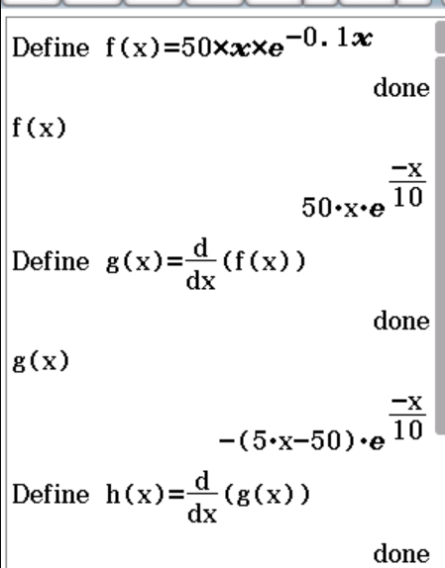
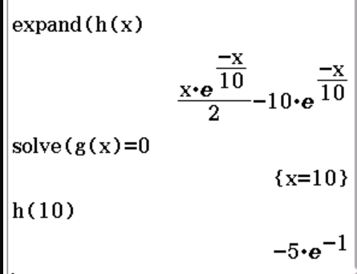


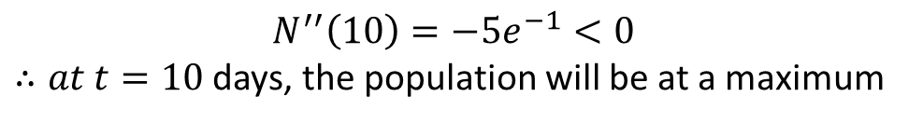


Guided Practice
The number N(t) of insects in a population at time t ,in days, is given by $N\left(t\right)=50te^{−0.1t}$. At what time will the population be at a maximum? Find the maximum population.
$$N^{′}\left(t\right)=50e^{−0.1t}+50t\left(−0.1\right)e^{−0.1t}$$
$$N^{′}\left(t\right)=50e^{−0.1t}−5te^{−0.1t}$$
$$N^{′}\left(t\right)=5e^{−0.1t}(10−t)$$
Sub $N^{′}\left(t\right)=0, 5e^{−0.1t}\left(10−t\right)=0$
Since $e^{−0.1t}>0, 10−t=0$
$$t=10$$
$$N^{′′}\left(t\right)=50\left(−0.1\right)e^{−0.1t}−5e^{−0.1t}−5t\left(−0.1\right)e^{−0.1t}$$
$$=−10e^{−0.1t}+0.5te^{−0.1t}$$
$$N^{′′}\left(10\right)=−5e^{−1}<0$$ $∴at t=10$ days, the population will be at a maximum
$Maximum pop=N\left(10\right)=500e^{−1}≈183$ insects

Slide 11

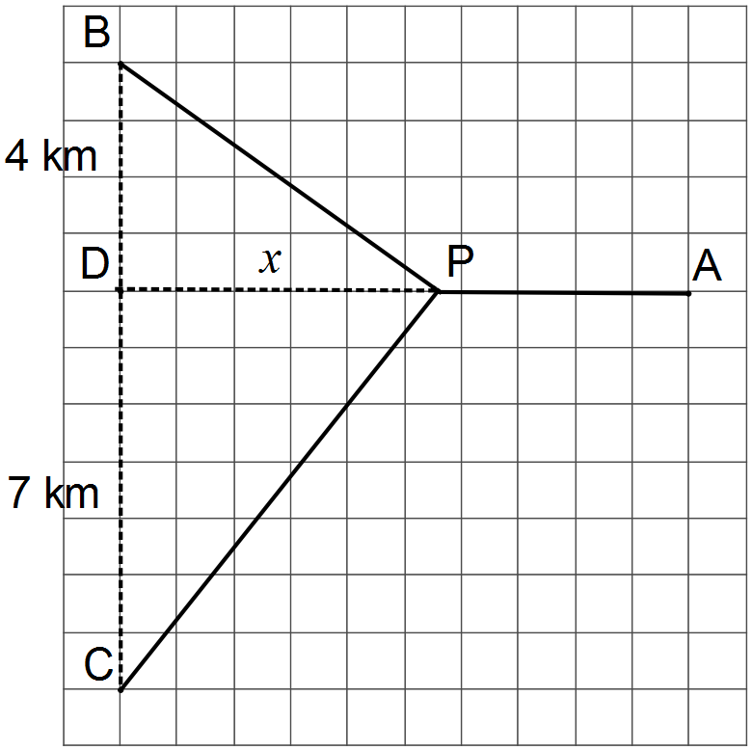
WACE Calculator Assumed (2, 4 Marks)
Three telecommunication towers, A, B and C, each need underground power cable connections directly to a new power station, P, that is to be built x km from depot D on a 10 km road running east-west between D and A.
Tower B lies 4 km due north of depot D and tower C lies 7 km south of the depot, as shown in the diagram.
Determine an expression for the total length of underground cable required to connect A, B and C directly to P.
Determine the minimum length of cable required

Slide 12
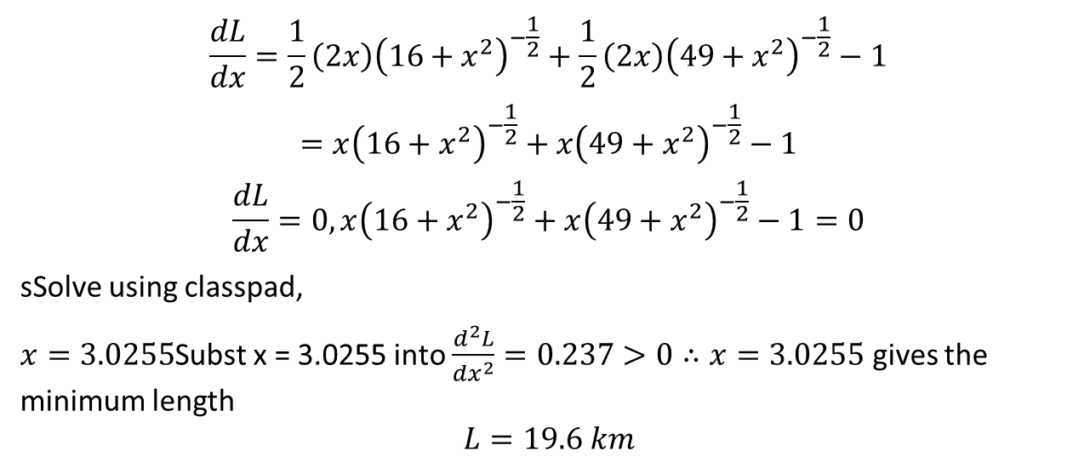







WACE Calculator Assumed (2, 4 Marks)
Three telecommunication towers, A, B and C, each need underground power cable connections directly to a new power station, P, that is to be built x km from depot D on a 10 km road running east-west between D and A.
Tower B lies 4 km due north of depot D and tower C lies 7 km south of the depot, as shown in the diagram.
Determine an expression for the total length of underground cable required to connect A, B and C directly to P.
Determine the minimum length of cable required
$$\frac{dL}{dx}=\frac{1}{2}\left(2x\right){\left(16+x^{2}\right)}^{−\frac{1}{2}}+\frac{1}{2}\left(2x\right){\left(49+x^{2}\right)}^{−\frac{1}{2}}−1$$
$$=x{\left(16+x^{2}\right)}^{−\frac{1}{2}}+x{\left(49+x^{2}\right)}^{−\frac{1}{2}}−1$$
$$\frac{dL}{dx}=0, x{\left(16+x^{2}\right)}^{−\frac{1}{2}}+x{\left(49+x^{2}\right)}^{−\frac{1}{2}}−1=0$$
sSolve using classpad,
$x=3.0255$Subst x = 3.0255 into $\frac{d^{2}L}{dx^{2}}=0.237>0∴x=3.0255$ gives the minimum length $$L=19.6 km$$

Slide 13
Independent Practice
Complete Cambridge Ex 5H

